Slide 1
OPERATING LEASE
Business Process in DSF Part 2
Presentate by Marion Jane
http://www.free-powerpoint-templates-design.com

Slide 2
Process in OLSS
BAST – Berita Acara Serah Terima
Billing Process
Monitoring Schedule Billing
Maintenance
Monitoring Asset
Monitoring Document Complement (STNK, KEUR, Insurance)
Asset Selling

Slide 3
Process in OLSS
BAST – Berita Acara Serah Terima
Billing Process
Monitoring Schedule Billing
Maintenance
Monitoring Asset
Monitoring Document Complement (STNK, KEUR, Insurance)
Asset Selling

Slide 4
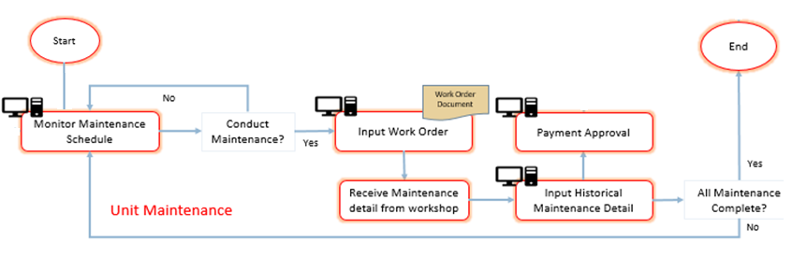
Maintenance

Slide 5
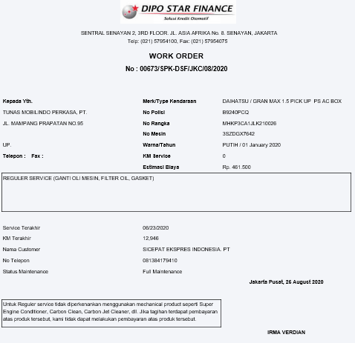
Maintenance

Slide 6
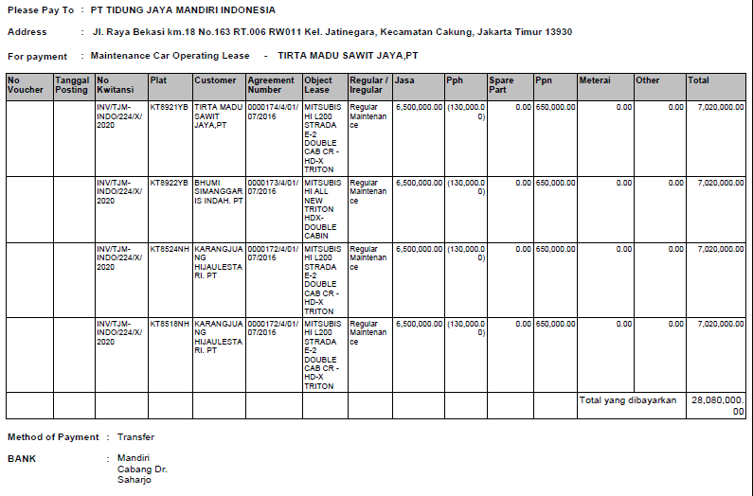

Slide 7
Process in OLSS
BAST – Berita Acara Serah Terima
Billing Process
Monitoring Schedule Billing
Maintenance
Monitoring Asset
Monitoring Document Complement (STNK, KEUR, Insurance)
Asset Selling

Slide 8
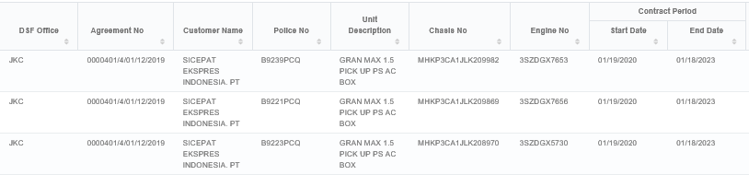
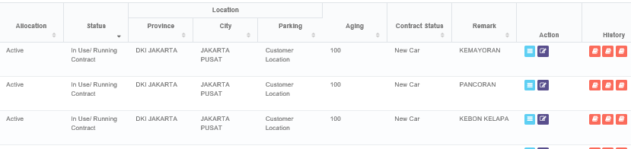
Monitoring Asset

Slide 9
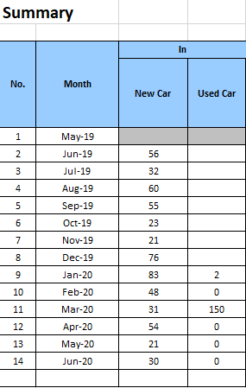
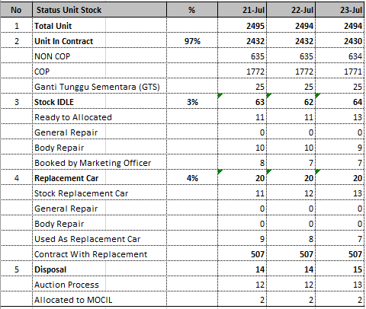
Monitoring Asset

Slide 10
Process in OLSS
BAST – Berita Acara Serah Terima
Billing Process
Monitoring Schedule Billing
Maintenance
Monitoring Asset
Monitoring Document Complement (STNK, KEUR, Insurance)
Asset Selling

Slide 11
Monitoring Document Complement
Contains Document STNK, KEUR, Insurance
Change Police Number
Renew expired date document
Input cost of renewal document
Automatic email at 1st date every month

Slide 12
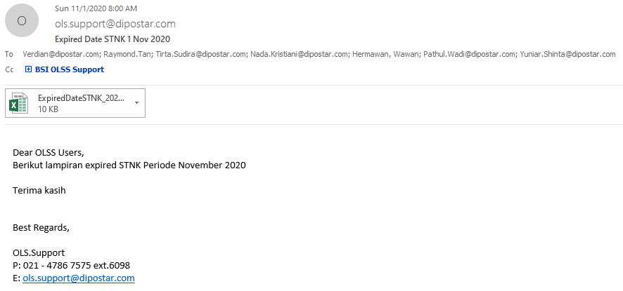
Monitoring STNK, KEUR & Insurance

Slide 13
Process in OLSS
BAST – Berita Acara Serah Terima
Billing Process
Monitoring Schedule Billing
Maintenance
Monitoring Asset
Monitoring STNK, KEUR & Insurance
Asset Selling

Slide 14
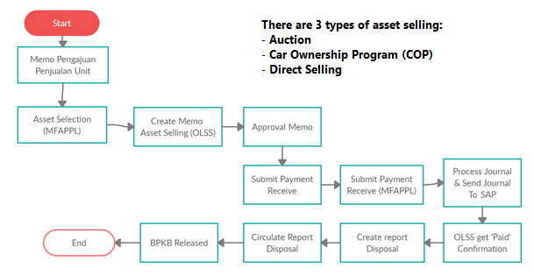
Asset Selling

Slide 15
Thank you!

